Slide 1
Cache hierarchy for modern computers
Name:Anwana Affiong Bassey
7138634
CEG 4136-PROF.M.BOLIC

Slide 2

Just a simple question
Does anyone know the two largest makers of computer microprocessors ???
Answer:
Intel and AMD, which is also know as Advance Micro Devices

Slide 3
OBJECTIVE
To discuss the cache hierarchy for modern computers. Touch a bit on the cache hierarchy of one the Intel processor microarchitecture and the 12 core AMD Opteron processor.

Slide 4
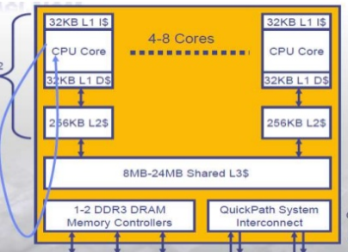
Cache hierarchy
Example :Intel processor microarchitecture cache hierarchy
Cache hierarchy or multilevel caches refers to memory designed generally to hold data which are most likely requested by the processors.

Slide 5

Intel’s cache hierarchy
3-level cache hierarchy
L1 cache-(32kb I +32 KB D, 8way)
4 cycles latency
L2 cache 256kb (unshared, per core, 8 way)
11 cycles latency
L3 cache up to 24MB(shared among all cores)
16way (30-40cycles), 24way(30-60cycles)
Line size-(64byte)

Slide 6
Split vs. unified caches
Split caches gives bandwidth
Unified gives flexibity
Usage of both give aggregate performance

Slide 7

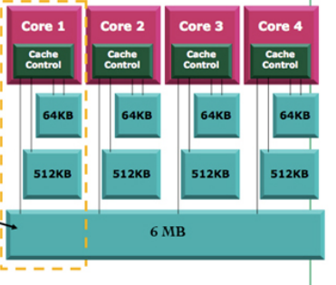
Cache hierarchy of the 12 co®e AMD Opteron processor
3-level hierarchy
L1 cache-(64kb I +64KB D, 2way)
Load-to-use 3 clock cycles
L2 cache -(512kbyte each, 16 way)
Best case Load-to-use is 12 clock cycles
L3 cache -6Mbyte
all caches(64byte lines)

Slide 8
Shared l3 cache
L3 cache in this design plays two roles in the design
A traditional cache associated with the processor
Storage for a cache directory

Slide 9
shared l3 cache configuration
6Mbyte is a victim cache
Built with two 1-Mbyte and 2-Mbyte sub-caches
Allows 1,2 & 4 sub-caches (each is 1 or 2-Mbyte)
uses the round-robin to victimize first, then LRU to victimize last
L3 cache as a victim reduces overlap between contents of L2 and L3 caches

Slide 10
QUESTION
This architecture only allows one, two or 4 sub caches either 1 or 2 Mbyte, please could anyone give a reason why?
Answer
it is because allows flexibility in system- on-chip (SoC) layouts and lets us use different sub-cache building blocks in different SoCs with reduced effort.

Slide 11
Sub-cache &Latency optimization
L3 cache optimizes both latency and bandwidth
cache lightly loaded operates in a latency reducing mode
processor tag probe assumes a hit and reserve necessary data buses and buffers in advance thereby minimizing latency
if line not present, request is forward to DRAM with minimal latency, otherwise……
Tags of the sub-caches are physically located near the l3 controller to provide hit/miss results with minimum possible latency

Slide 12
QUESTION
when the request rate is high and the L3 cache does not contain enough resources, does anyone know what happens?
Answer
So the L3 cache controller sends the request to the tags as a query only, which will determine the cache status without initiating a data transfer.

Slide 13
Bandwidth(l3-cache)
A dedicated read buffer holds data from each sub-cache until it can be returned to the requesting core
A dedicated write buffer per core holds the allocation data until it can be written to the cache
Combined L3 data read and write bandwidth is limited to two 64byte cache line access per block

Slide 14
Can we have many copies of shared data in the caches?
Now with cache coherence, it a protocol that ensures each level of caches have the most recent data
Yes it can

Slide 15
coherency
Misses in l3 cache, memory controller is the ordering point of request from different cores.
Data movement in and out of l3 then its controller must ensure no coherency violation

Slide 16
QUESTION
With multi-programmed workloads, if a program running on one core has poor caching characteristics in what way will it affect things?
ANSWER
it could negatively affect the cache performance of programs running on other cores and the situation can be detected when a core exhibits a high in- stall rate and a low cache hit rate, which indicates that it is not benefiting much from the L3 cache and is probably polluting the cache for other cores.

Slide 17
question
Does anyone have an idea of what Xfire means?
Answer:
It is a bandwidth which is a useful metrics for evaluating and comparing topologies.

Slide 18
conclusion
Researching this topic provided a good insight on each level of caches (the level 1 , 2 and 3 caches) . Which we currently studied in computer architecture and are yet to go in depth in this course in topics like
coherency
Different Optimizations performed on the level of caches

Slide 19
THANK YOU

Slide 20
References
B.Hughes,G.Donelyp.comway, N.kalyanasundharam(2010 March). Retrieved from file:///Users/jenny/Downloads/Cache%20Hierarchy%20and%20Memory%20Subsystem%20of%20the%20AMD%20Opteron%20Processor%20(1).pdf
Segalini, (2015). [online].Retrived from: http://home.deib.polimi.it/silvano/FilePDF/ARC-MULTIMEDIA/Segalini%20Simone%20739362%20-%20AMD%20Opteron%20Processor%20Presentation.pdf [Accessed 21 Sep. 2017].
mohammadradpour (2015). Intel® Nehalem Micro-Architecture. [online] Slideshare.net. Available at: https://www.slideshare.net/mohammadradpour/nehalem-49037869?next_slideshow=1 [Accessed 21 Sep. 2017].
N.A,(2017).[online]aAvailable at:https://en.wikipedia.org/wiki/Cache_coherence

